Slide 1
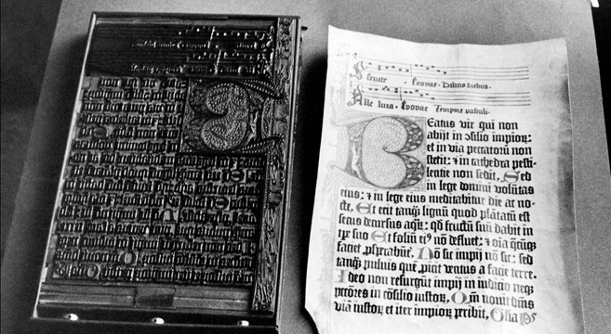
Extending and Writing with Gutenberg
By: Daniel Greig

Slide 2

Daniel Greig
Tech/Team Lead at Earthling Interactive
CMS/Ecommerce Architect at Earthling Interactive
Co-organizer Madison Wordpress meetup
Have a pair of cats who think I spend way to much time in front of the computer and not loving them.

Slide 3
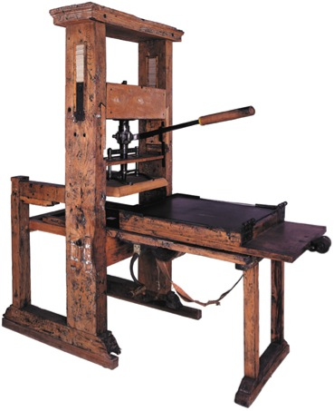
The GuTENBERG PRESS
Notes:
Developed in 1439

Slide 4
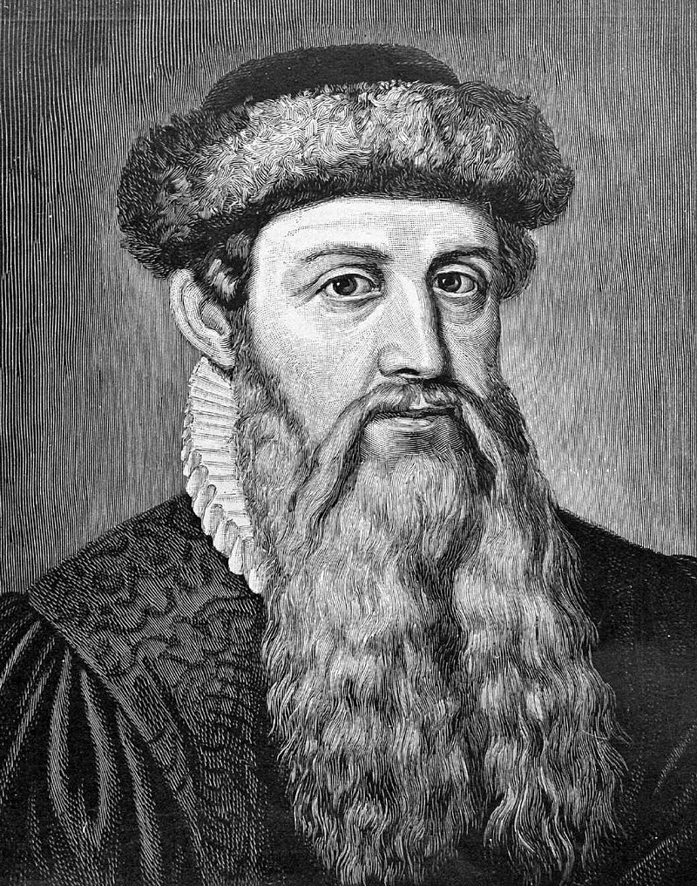
Johannes Gutenberg
First European to use movable type
Invention of a process for mass-producing movable type
The use of oil-based ink for printing books
Adjustable molds
Mechanical movable type
The use of a wooden printing press similar to the agricultural screw presses of the period.
Notes:
Asia did use movable type first but the latin alphabet is simpler 26 characters compared to the 130 that are needed for Asian languages

Slide 5
What Gutenberg is
Extendable Content builder
Provides a standard set of blocks for content creation
Creation of Reusable Blocks
What You See Is Probably Close Enough To What You Get
(WYSIPCETWYG)

Slide 6

Building Block
Common Blocks
Formatting
Paragraph
Image
Gallery
Heading
Quote
List
Cover Image
Video
Audio
Pullquote
Table
Preformatted
Code
Custom HTML
Classic Text
Verse
Layout Blocks
Widgets
Separator
More
Button
Text Columns
Latest Posts
Catagories
Shortcode
Notes:
Pull Quote – Blockquote with Cite element
Verse is a <pre> block
Cover – Image set as background cover with centered title. Limited editing on the title.

Slide 7

What gutenberg isn’t
Theme
Responsive
Structured Data
Magic

Slide 8
When Will it be Released
Development Started: Nov. 15th 2017
Released into Core: Nov. 19th 2018
Plugin: NOW!
Notes:
Wordpress 4.9.8 Large panel that advertised guttenberg.
November 5, 2018 Beta 4
November 12, 2018 Release Candidate 1 and hard string freeze.
November 18, 2018 Dry run for release of WordPress 5.0 and 24 hour code freeze.
November 19, 2018 Target date for release of WordPress 5.0.

Slide 9

Wordpress 5.0 release: Current sites

Slide 10
Wordpress 5.0 – Panic?
You can turn Gutenberg off
https://wordpress.org/plugins/disable-gutenberg/
Classic Editor is offered as a Plugin
Conflicts with plugins that the site relies on
Users don’t want to learn something new
You have accessibility concerns

Slide 11


Slide 12


Slide 13


Slide 14
What can I Do
User Training
Limit the Blocks available
Restrict Options available for blocks
Prefill out options for the blocks
Set reasonable defaults
Configure things by post type

Slide 15
Limit the Blocks
<?php function my_gutenberg_blocks() {
return array( 'core/paragraph’,
'core/image’,
'core/gallery’,
'core/table’,
);
}
add_filter( 'allowed_block_types', 'my_gutenberg_blocks' );

Slide 16
Limit Blocks by POST TYPE
function theme_gutenberg_blocks_post($allowed_block_types) {
if ( get_post_type() == 'post' ) {
return array(
'core/paragraph',
'core/image',
'core/gallery',
'core/table',
);
}else{
return $allowed_block_types;
}
}
add_filter( 'allowed_block_types’, theme_gutenberg_blocks_post’, 10);

Slide 17
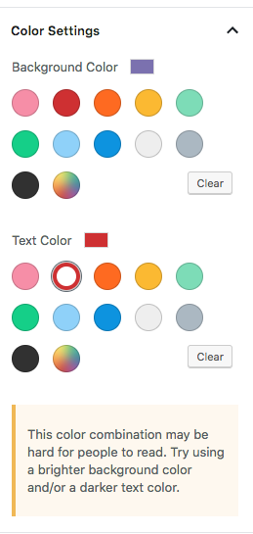
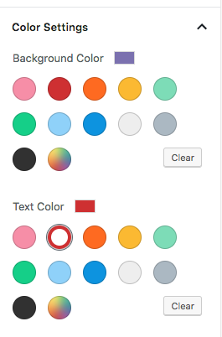
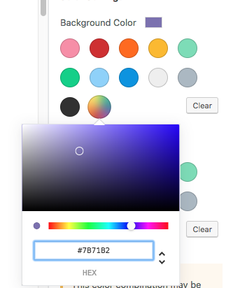
Colors
Color Warnings
Text Editor colors
Custom Colors
Notes:
Color Palette is used:
Paragraph – background colors, Text Colors
Cover image – Overlay color

Slide 18
Colors
Remove the ability for custom colors
function theme_gutenberg_disable_custom_colors() {
add_theme_support( 'disable-custom-colors' );
}
add_action( 'after_setup_theme', 'theme_gutenberg_disable_custom_colors' );

Slide 19
Colors:
Create the Palette specific to the brand.
function theme_gutenberg_color_palette() {
add_theme_support(
'editor-color-palette', array(
array(
'name' => esc_html__( 'Custom Black'),
'slug' => 'black',
'color' => '#2a2a2a',
),
array(
'name' => esc_html__( 'Shiny White'),
'slug' => 'white',
'color' => '#FFFFFF',
)
)
);
}
add_action( 'after_setup_theme', 'theme_gutenberg_color_palette' );

Slide 20
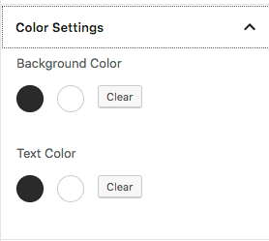
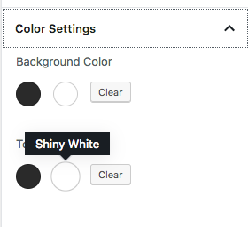
Colors:
Create the Palette specific to the brand.
New classes for backgrounds:
.has-black-background-color
.has-white-background-color
New classes for text:
.has-black-color
.has-white-color
It’s possible to add customizable colors to a theme that can be pulled into the palette
All color palettes will be the same unless block is specifically programmed otherwise

Slide 21
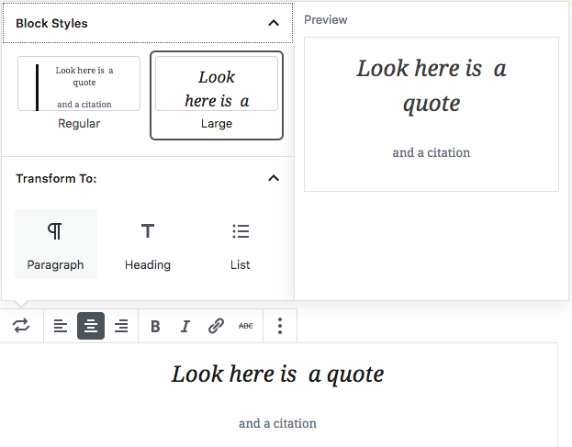
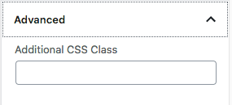
Block Styling

Slide 22
Adding Styles
gutenberg.js
wp.blocks.registerBlockStyle( 'core/quote', {
name: 'fancy-quote',
label: 'Fancy Quote'
} );

Slide 23
Enqueue script
Theme functions.php
function theme_gutenberg_styles() {
wp_enqueue_script(
'theme-gutenberg-styles',
get_template_directory_uri() . '/assets/js/gutenberg.js',
array( 'wp-blocks' )
);
}
add_action( 'enqueue_block_editor_assets', 'theme_gutenberg_styles' );

Slide 24
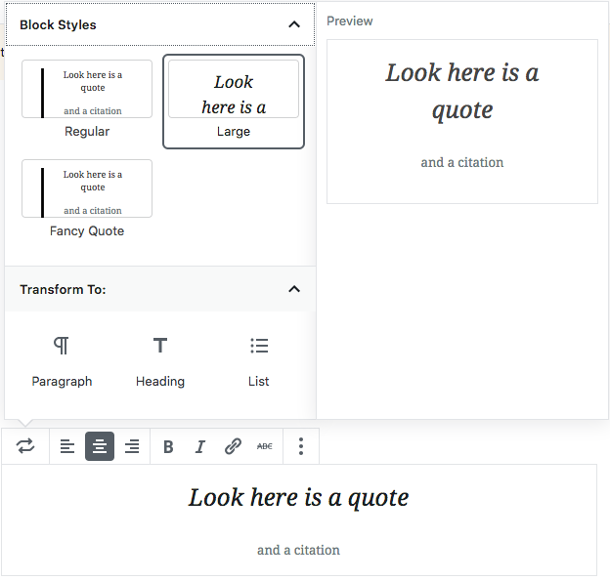
Style Selection

Slide 25
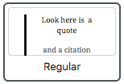
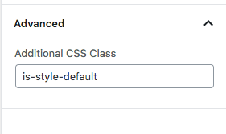
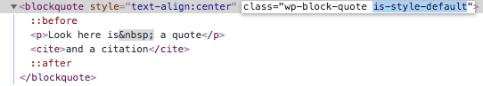
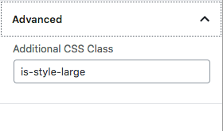
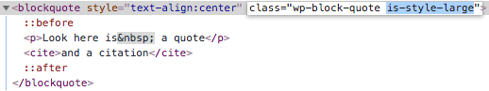
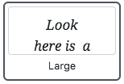
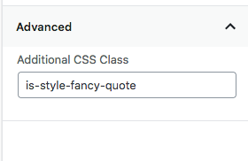
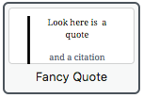
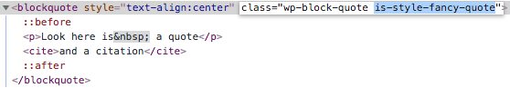
Block Styles

Slide 26
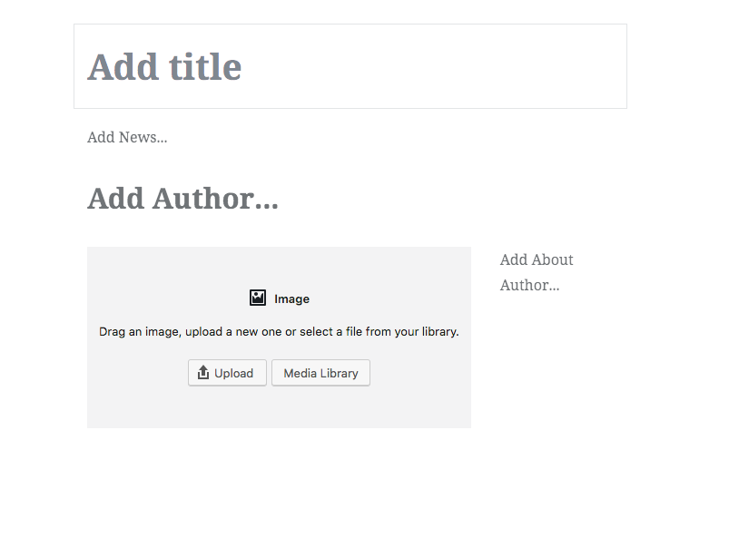
Custom Post type Templates
function create_post_news() {
register_post_type( 'news',
array(
'template' => array(
array( 'core/paragraph', array(
'placeholder' => 'Add News...',
) ),
array( 'core/heading', array(
'placeholder' => 'Add Author...',
) ),
array( 'core/image', array(
'align' => 'left',
) ),
array( 'core/paragraph', array(
'placeholder' => 'Add About Author...',
) ),
),

Slide 27
Custom Post type Locking
'template_lock' => 'insert’,
insert — prevents inserting or removing blocks, but allows moving existing blocks.
all — prevents all operations. It is not possible to insert new blocks, move existing blocks, or delete blocks.
Notes:
If either of these are used no new blocks can be placed on the page. This I an issue if something needs multiple paragraphs.

Slide 28
MetaBoxes
Metaboxes are fully supported as of May 2018
Metaboxes appear below the content window
Saved on article save
Gutenberg makes an extra submission for this

Slide 29
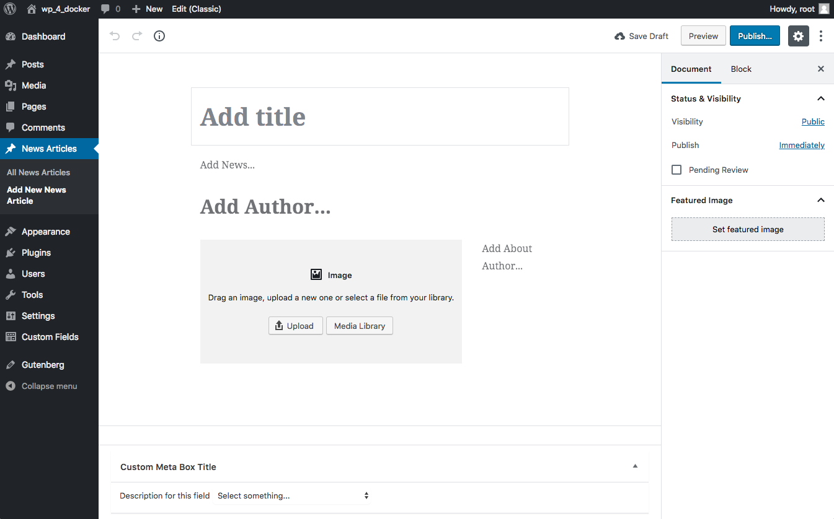

Slide 30
Gutenberg on Metabox
Suggest moving all meta boxes that can be into blocks
If current Metabox causes issues
Add array( '__block_editor_compatible_meta_box' => false ) to the add_meta_box
This will force Classic editor.
Backwards Compatibility
array( '__back_compat_meta_box' => false, )
Useful if meta box is moved to a block but there is a chance that other meta boxes force the classic Editor

Slide 31
Metabox – why is it broke?
Plugins relying on selectors that target the post title, post content fields, and other metaboxes (of the old editor).
Plugins relying on TinyMCE’s API because there’s no longer a single TinyMCE instance to talk to in Gutenberg.
Plugins making updates to their DOM on “submit” or on “save”.

Slide 32
Advanced Custom Fields
Field groups can be Meta boxes
Show at the bottom of the editor
Still usable as they were before.
5.8 Beta has new Block creation ability

Slide 33
ACF – Block - Init
add_action('acf/init', 'my_acf_init');
function my_acf_init() {
// check function exists
if( function_exists('acf_register_block') ) {
// register a testimonial block
acf_register_block(array(
'name' => 'author',
'title' => __('Author'),
'description' => __('An Author Block.'),
'render_callback' => 'my_acf_block_render_callback',
'category' => 'formatting',
'icon' => 'admin-comments',
'keywords' => array( 'author' ),
));
}
}

Slide 34
ACF – Block – Template Callback
function my_acf_block_render_callback( $block ) {
// convert name ("acf/author") into path friendly slug (”author")
$slug = str_replace('acf/', '', $block['name']);
// include a template part from within the "template-parts/block" folder
if( file_exists(STYLESHEETPATH . "/template-parts/block/content-{$slug}.php") ) {
include( STYLESHEETPATH . "/template-parts/block/content-{$slug}.php" );
}
}

Slide 35
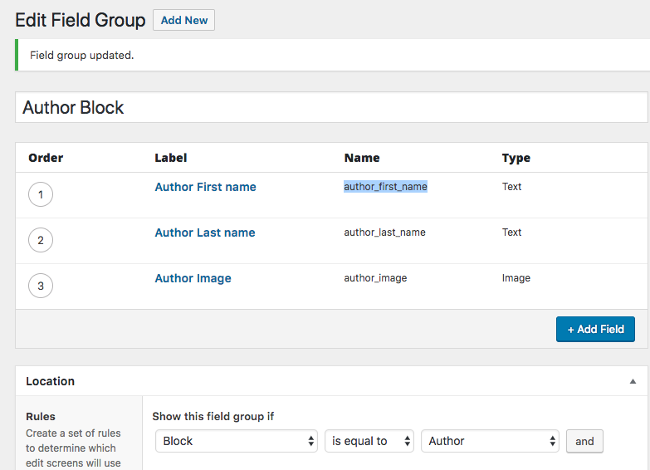
ACF – BLOCK – Field Group

Slide 36
ACF – BLOCK – TEMPLATE part
<?php
// get image field (array)
$avatar = get_field('author_image');
// create id attribute for specific styling
$id = 'author-' . $block['id'];
?>
<div id="<?php echo $id; ?>" class="author_block">
<p class="authorHeadline">Author Info:</p>
<img class="authorImage" src="<?php echo $avatar['url']; ?>" alt="<?php echo $avatar['alt']; ?>" />
<p class="byline"><?php echo get_field('author_first_name') . ' ' . get_field('author_last_name'); ?></p>
<div class="clr"></div>
</div>

Slide 37
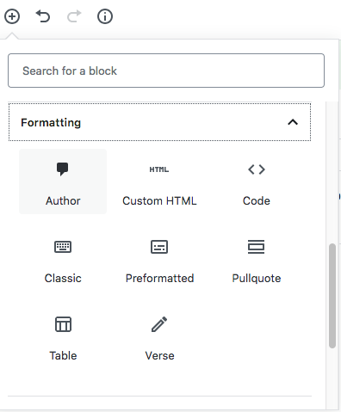
ACF – BLOCK IN use

Slide 38
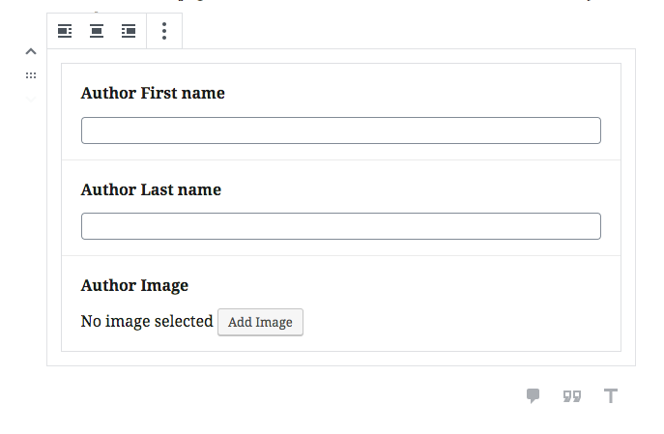
ACF – BLOCK – in editor

Slide 39
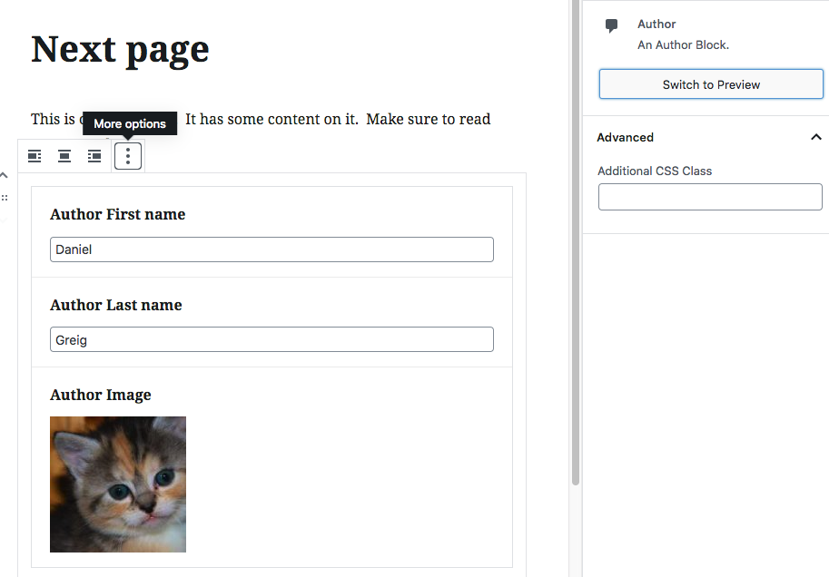
ACF – Block – Switch to preview

Slide 40
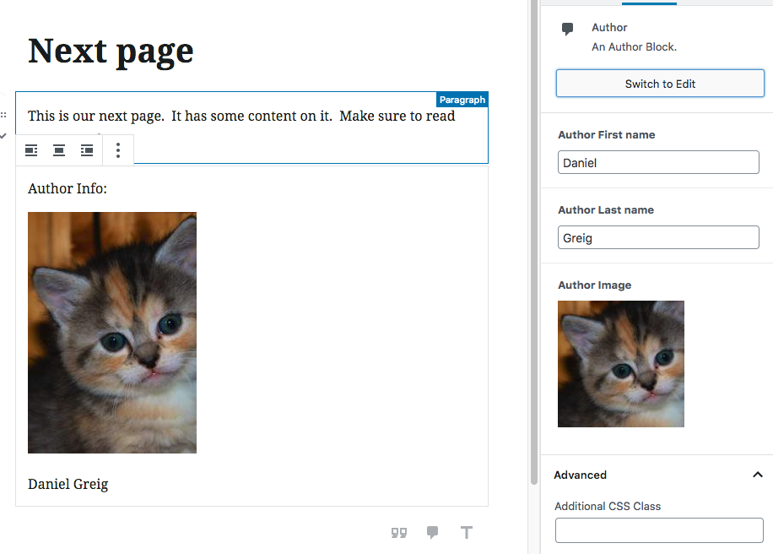
ACF – Block – Switch to preview

Slide 41
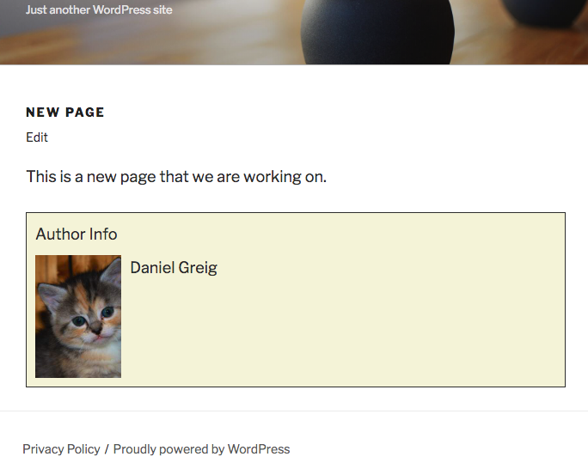
ACF – BLOCK – on page

Slide 42
ACF – BLOCKs - MEtaboxes
Metaboxes connect data to a post
Blocks put content into a post content area
Notes:
The difference here is huge and not depending on what the developer is trying to do.

Slide 43
Reusable Blocks
Update once update everywhere used.
Good for Call-outs

Slide 44
Helpful links
https://wordpress.org/plugins/classic-editor/
https://wordpress.org/gutenberg/handbook/reference/faq/#how-will-editor-styles-work - Loading styles into gutenberg editor
https://github.com/WordPress/gutenberg/labels/Accessibility - Accessibility
https://wordpress.org/gutenberg/handbook
https://wordpress.org/gutenberg/handbook/blocks/ Block Creation
https://richtabor.com/gutenberg-customizer-colors/ Customizer colors into palette
https://wordpress.org/plugins/block-unit-test/ Block creator for style testing.
https://wordpress.org/gutenberg/handbook/templates/ - Locked Templates
https://wordpress.org/gutenberg/handbook/extensibility/extending-blocks/#hiding-blocks-from-the-inserter - Removing blocks
https://richtabor.com/add-wordpress-theme-styles-to-gutenberg/ - (WYSIPCETWG)

Slide 45

Questions?

Slide 46

Thanks for your time
Daniel Greig
greig@earthlinginteractive.com

Slide 47
Topics I didn’t touch
Creating blocks ( React )
What this means for Page builders
Accessibility concerns

